Slide 1
00/00/0000
Company Name

Slide 22
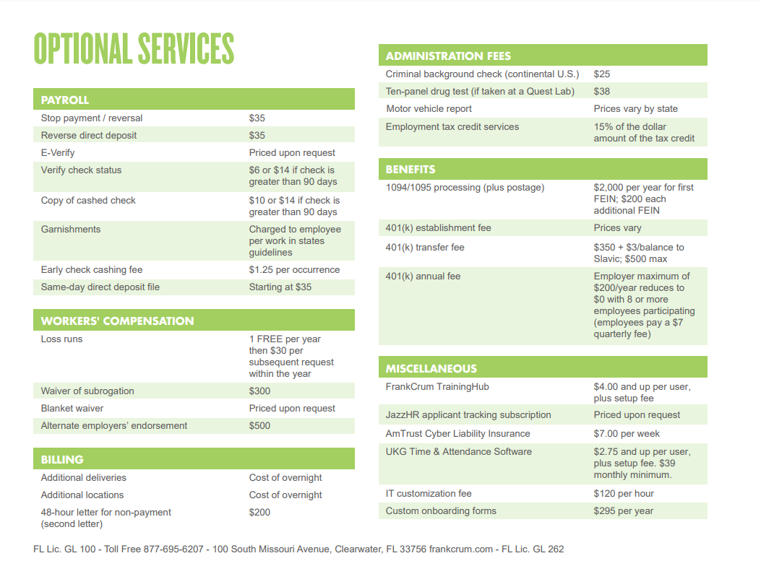

Slide 27
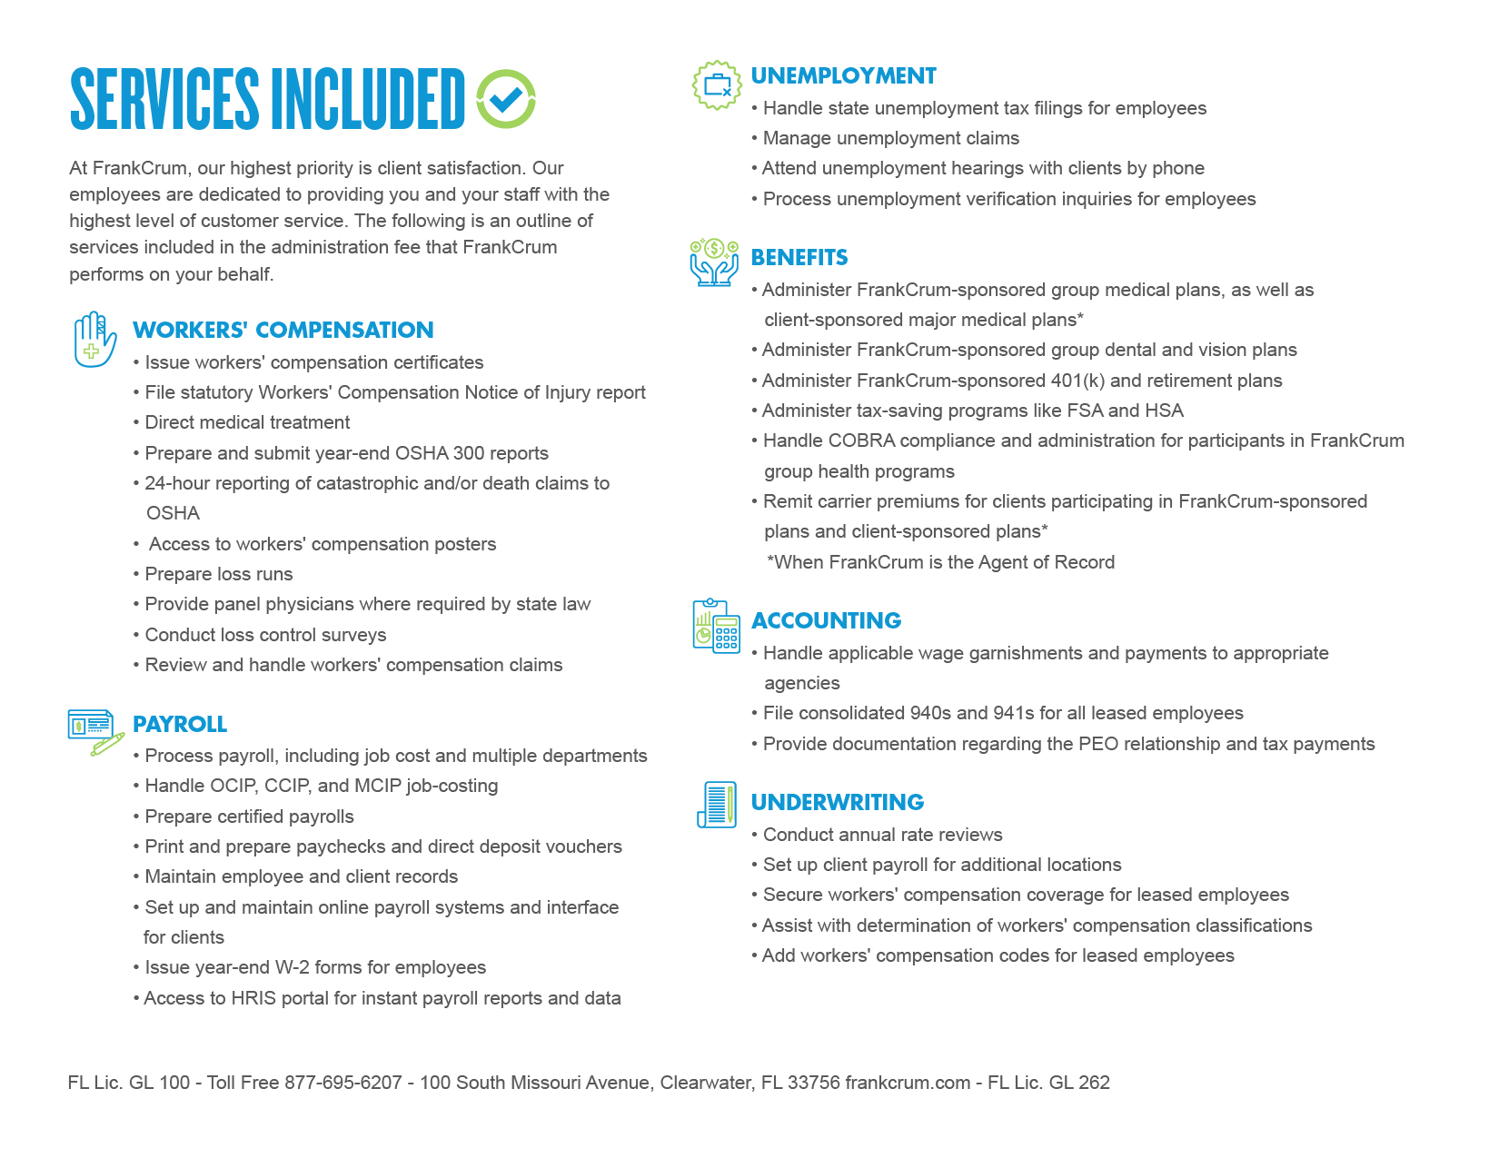

Slide 28
23

